Slide 1

RNA-Seq analysis
Dr. Cheng Zhang
KTH-Royal Institute of Technology
http://sysmedicine.com

Slide 2
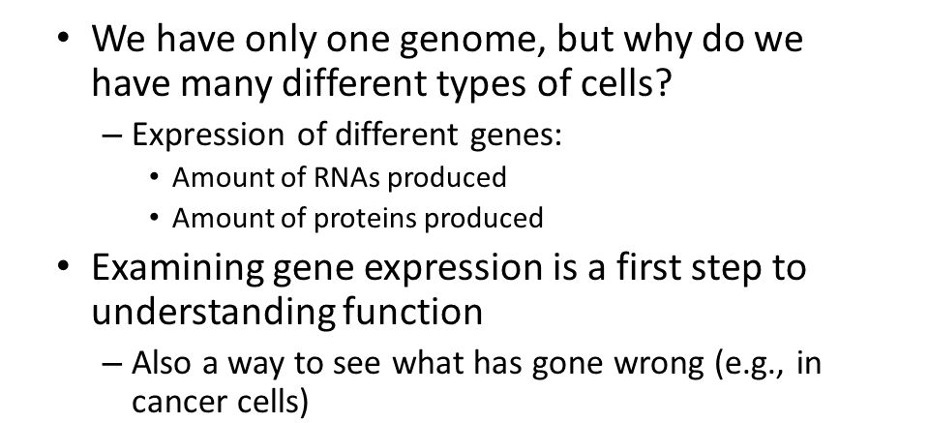
Why gene expression

Slide 3
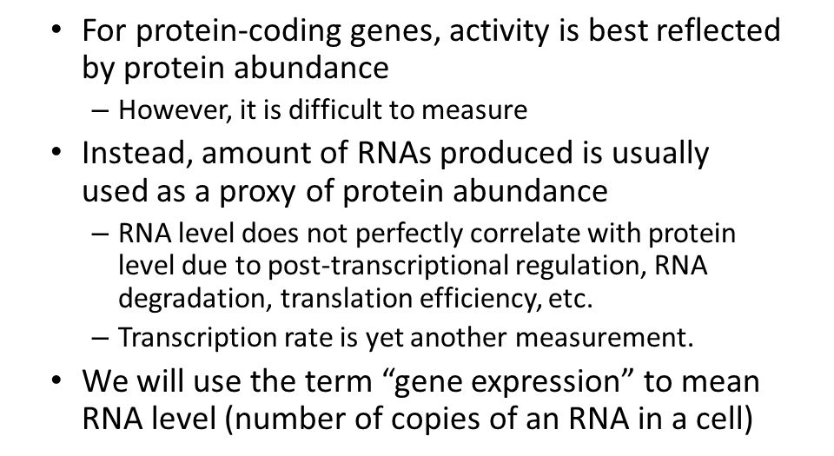
Why gene expression

Slide 4
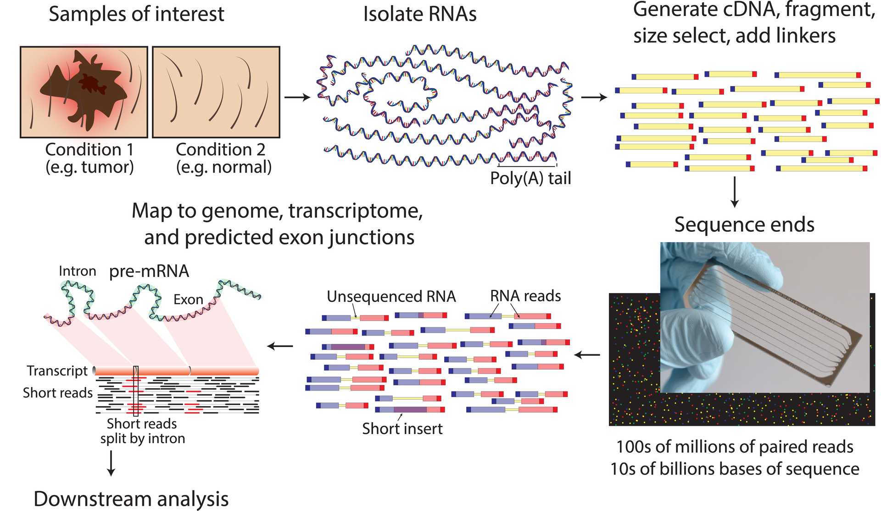
RNA-Sequencing workflow
https://youtu.be/fCd6B5HRaZ8

Slide 5
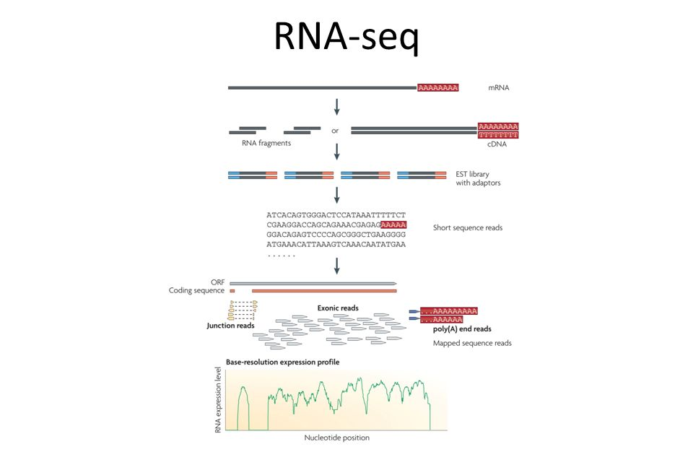
RNA-Sequencing workflow

Slide 6
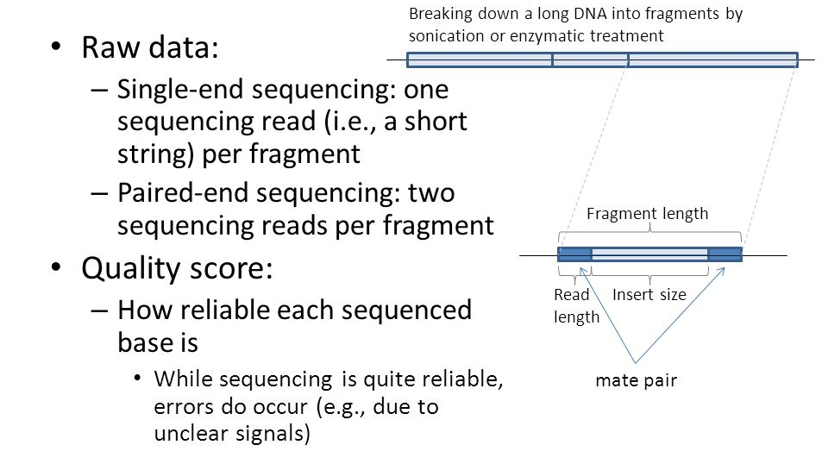
Single- vs Paired-ended sequencing

Slide 7
Single- vs Paired-ended sequencing
Paired-end RNA sequencing (RNA-Seq) enables discovery applications such as detecting gene fusions in cancer and characterizing novel splice isoforms.

Slide 8
Quality control of RNA-Seq
NGI ID | User ID | Mreads | >=Q30
P10310_1001 | Basophils_2 | 19.77 | 96.69
P10310_1002 | Eosinophils_3 | 20.38 | 96.64
P10310_1003 | Classical_monocytes | 21.78 | 96.44
P10310_1004 | Intermediate_monocytes | 21.9 | 96.67
P10310_1005 | Non_classical_monocytes | 17.96 | 96.5
P10310_1006 | MAIT | 29.2 | 96.43
P10310_1007 | gt_T | 18.77 | 96.63
P10310_1008 | Total_PBMCs | 17.03 | 95.11
P10310_1009 | Plasma_DC | 19 | 96.65
P10310_1010 | Myeloid_DC | 16.72 | 96.72
P10310_1011 | Naive_B | 16.23 | 96.2
P10310_1012 | Memory_B | 18.26 | 96.1
P10310_1013 | NK | 12.12 | 93.15
P10310_1014 | Memory_CD4 | 16.19 | 96.47
P10310_1015 | Naive_CD4 | 20.59 | 95.68
P10310_1016 | Naive_CD8 | 14.92 | 94.08
P10310_1017 | Memory_CD8 | 19.01 | 96.75
P10310_1018 | Tregs | 19.99 | 95.41
P10310_1019 | Neutrophils_2 | 16.31 | 96.25
What is Mreads?
Mreads is million reads, and it is a indicator the the sequencing depth. Usually, 10 Mreads is required to ensure asample is good.
What is Q30?
Q stands for Phred Quality Score, and 30 is the base calling error probability.
In brief, Q30 is equivalent to the base call accuracy of 99.9%, which means only 1 out of 1000 base call is incorrect.

Slide 9
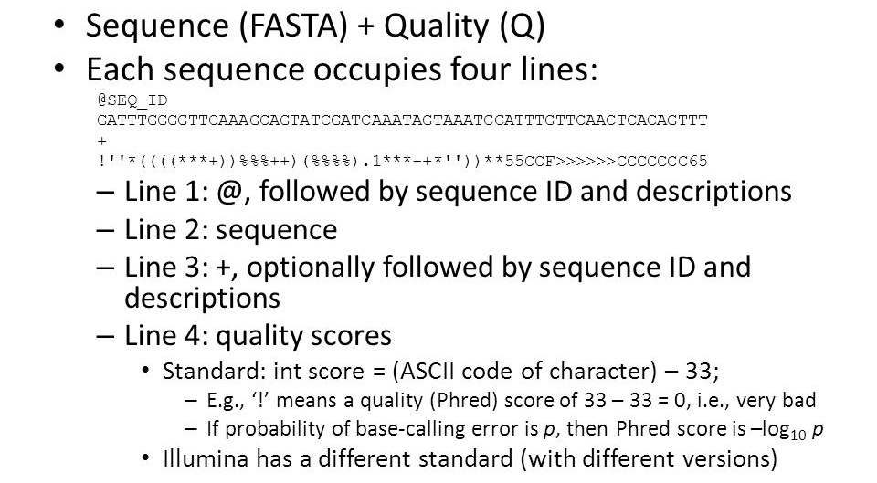
Fastq files

Slide 10
Proceed from fastq files to gene counts/TPM
We have many steps to get numerical data from Fastq files
Quality check
Read trimming and filtering
Read mapping
Data normalization
Ultimately, from a high-throughput gene expression experiment, we get a vector of real numbers, corresponding to the expression values of the genes
Tools
HTSeq (HTSeq-a Python framework to work with high-throughput sequencing data, 2015)
Kallisto (Near-optimal probabilistic RNA-seq quantification, 2016)

Slide 11
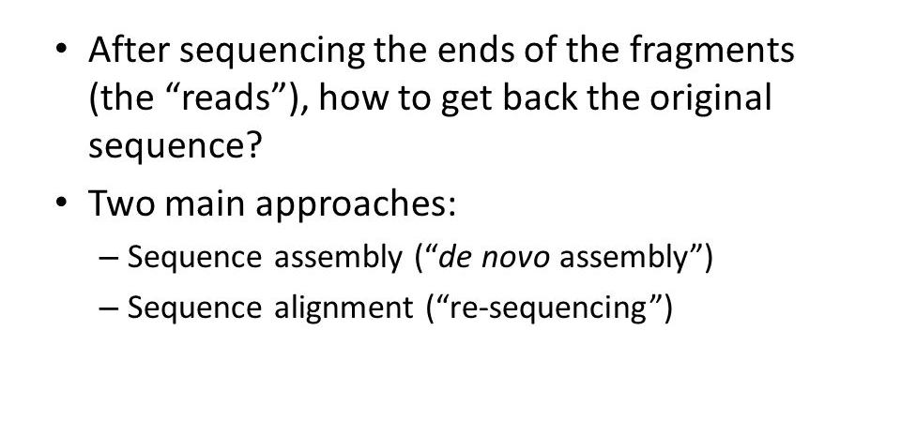
Proceed from fastq files to gene counts/TPM

Slide 12
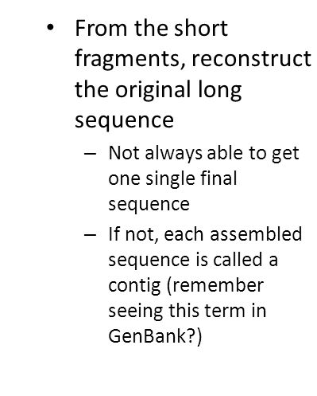
Proceed from fastq files to gene counts/TPM

Slide 13
Count, CPM, RPKM, FPKM and TPM
Raw read counts:
number of reads that mapped to a certain gene
Normalization: if expression of different genes or the same gene in different datasets are to be compared
Longer genes are expected to get more reads
For a sample with more reads (deeper sequenced), each gene gets more reads on average

Slide 14
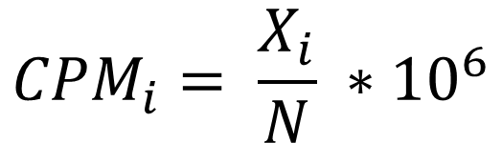
Count, CPM, RPKM, FPKM and TPM
CPM (counts per million):
Counts per million (CPM) mapped reads are counts scaled by the number of fragments you sequenced (N) times one million.
$${CPM}_{i}= \frac{X_{i}}{N} ∗{10}^{6}$$
Normalized with sequencing depth, but not gene length
Good to compare same genes between different samples

Slide 15
Effective length
the "effective length" equals: gene length - reads length + 1 or reads length - gene length + 1
Reference gene
Read
Effective length

Slide 16
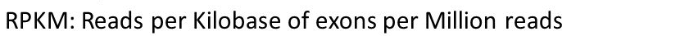

Count, CPM, RPKM, FPKM and TPM
$${RPKM}_{i}= \frac{X_{i}∗{10}^{3}}{N∗L_{i}} ∗{10}^{6}$$
Here, 10^3 normalizes for gene length and 10^6 for sequencing depth factor.
FPKM (Fragments per kilo base per million mapped reads) is analogous to RPKM and used especially in paired-end RNA-seq experiments. In paired-end RNA-seq experiments, two (left and right) reads are sequenced from same DNA fragment. When we map paired-end data, both reads or only one read with high quality from a fragment can map to reference sequence. To avoid confusion or multiple counting, the fragments to which both or single read mapped is counted and represented for FPKM calculation.

Slide 17
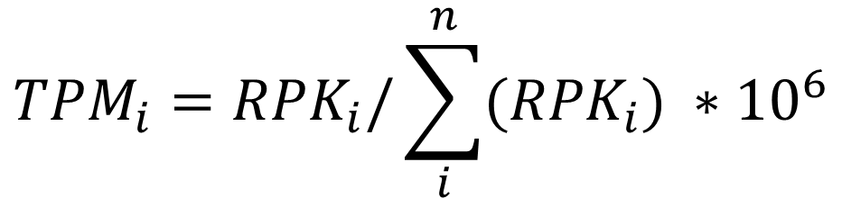
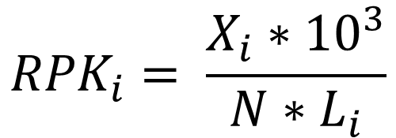
Count, CPM, RPKM, FPKM and TPM
TPM (Transcript per million)
$${RPK}_{i}= \frac{X_{i}∗{10}^{3}}{N∗L_{i}}$$
$${TPM}_{i}={RPK}_{i}/\sum_{i}^{n}{({RPK}_{i})} ∗{10}^{6}$$
TPM is very similar to RPKM and FPKM. The only difference is the order of operations. Here’s how you calculate TPM:
Divide the read counts by the length of each gene in kilobases. This gives you reads per kilobase (RPK).
Count up all the RPK values in a sample and divide this number by 1,000,000. This is your “per million” scaling factor.
Divide the RPK values by the “per million” scaling factor. This gives you TPM.
.

Slide 18












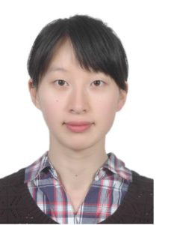

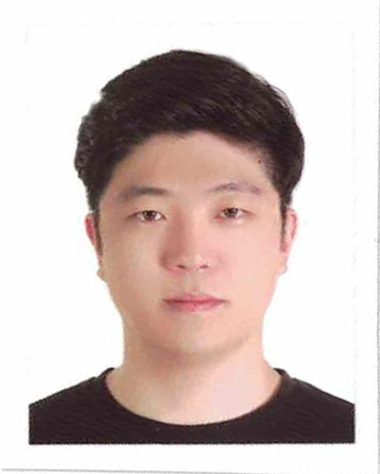

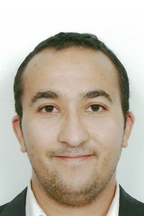



Systems medicine group@ SciLifeLab
Computational Biology
Cheng Zhang
Senior Researcher
Sunjae Lee
Senior Researcher
Ida Larsson
MSc Student
Reza Bidkhori
Post doc
Rui Benfeitas
Post doc
Muhammad Arif
PhD stud.
Alen Lovric
Research Eng
Dorines Rosario
Research Eng
Mohamed Alshobky
MSc Student
Experimental Biology
Beste Turanli
Vis Student
Feride Eren
Vis Student
Ozlem Altay
Vis Resarcher
Shuqi Zhang
Vis Resarcher
Zhengtao Liu
Post doc
Woong Hee Kim
Post doc
Natasa Sikanic
Researcher
Medicinal Chemistry
Computational Chemistry
Faddy Aziz
Post doc
Umberto Battisti
Post doc
Chiara Zagni
Post doc
Anders Füchtbauer
Post doc
Leticia Gómez
Post doc
Chunxia Gao
Post doc

Slide 19
Acknowledgements
SciLifeLab
Prof. Mathias Uhlen
Ass. Prof. Emma Lundberg
Ass. Prof. Simon Elsässer
Chalmers University of Technology
Prof. Jens Nielsen
University of Groningen
Albert K. Groen
University of Gothenburg
Prof Jan Boren
Prof Ulf Smith
Prof. Fredrik Bäckhed
Prof. Lena M Carlsson
Prof. Stefano Romeo
Prof. Morten Grötli
Prof. Leif Eriksson
University of Amsterdam
Mireille J. Serlie
King's College London
Ass. Prof. Saeed Shoaie
Stanford University
Prof. Michael Snyder
Dr Brian D Piening
NIH
Prof. George Kunos
Dr Resat Cinar
Bani Mukhopadhyay
Helsinki University
Prof Marja-Riitta Taskinen
Imperial College London
Prof. Philippe Froguel
Prof. Andrew J Walley
University of Leipzig
Prof. Matthias Blüher

Slide 20






Acknowledgements
20

